Slide 1
Module 2
Memory Management, Memory Partitioning

Slide 2
Allocation Methods in Contiguous Memory Allocation

Slide 3
Allocation Methods
Operating System
First Fit
Allocate the first hole that is big enough
Next Fit
Same as First Fit but start search always from the last allocated hole
Best Fit
Allocate the smallest hole that is big enough
Worst Fit
Allocate the largest hole

Slide 5
Non-contiguous Memory Allocation

Slide 6
Non-contiguous allocation
Process (P1)
6 KB
Process will be divided and allocated in different places in Main Memory
Operating System

Slide 7
Concept of Paging
Paging is a storage mechanism that allows OS to retrieve processes from the secondary storage into the main memory in the form of pages
In the Paging method, the main memory is divided into small fixed-size blocks of physical memory, which is called frames
Process is divided into pages
The size of a frame should be kept the same as that of a page to have maximum utilization of the main memory and to avoid external fragmentation

Slide 8
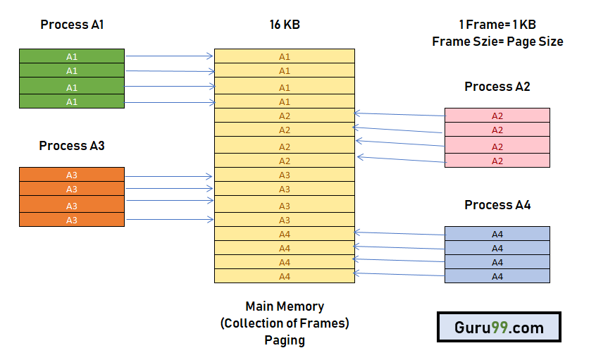
Concept of Paging

Slide 12
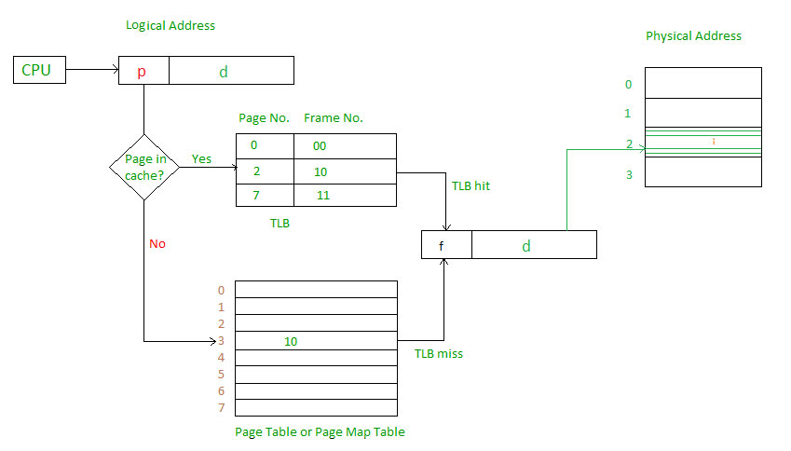
How Paging Works?

Slide 13
How Paging Works?

Slide 14
Advantages and Disadvantages of Paging
Paging reduces external fragmentation, but still suffer from internal fragmentation.
Paging is simple to implement and assumed as an efficient memory management technique.
Due to equal size of the pages and frames, swapping becomes very easy.
Page table requires extra memory space, so may not be good for a system having small RAM.

